Slide 1
Securing Big data in the AGE OF AI

Slide 2
CONFERENCE AND PAPER
2019 First IEEE International Conference on Trust, Privacy and Security in Intelligent Systems and Applications (TPS-ISA)
Domain: Security and Privacy
Authors:
Murat Kantarcioglu, University of Texas at Dallas and Data Security Technologies LLC
Fahad Shaon, University of Texas at Dallas and Data Security Technologies LLC

Slide 3

big data and what is AI: An Overview
Big Data:
Big Data is a collection of data that is huge in volume, yet growing exponentially with time.
It is a data with so large size and complexity that none of traditional data management tools can store it or process it efficiently.
Big data is also a data but with huge size.
Artificial Intelligence (AI):
Refers to the simulation of human intelligence in machines that are programmed to think like humans and mimic their actions.
The term may also be applied to any machine that exhibits traits associated with a human mind such as learning and problem-solving.

Slide 4
How AI is Used in big data ?
An AI system needs to learn from data in order to be able to fulfill its function.
AI’s ability to work so well with data analytics is the primary reason why AI and Big Data are now seemingly inseparable.
“Using data from multiple sources, AI can build a store of knowledge that will ultimately enable accurate predictions about you as a consumer.
Data and AI are merging into a synergistic relationship, where AI is useless without data and data is insurmountable without AI.

Slide 5

Why secure big data?
Organizations are collecting ever larger amounts of data to build complex data analytics, machine learning and AI models
Data may be unstructured (e.g., text, image, and video)
Data may be stored in different data management systems
Ranging from relational databases to newer NoSQL databases
Increasingly using programming languages such as Python, R etc
The developed code will be automatically executed by the NoSQL system on the stored data

Slide 6
Benefits of NoSQL:
NOSQL databases have been developed to handle big data challenges and issues including the need for scalable, rapid and distributed databases.
NoSQL are a database management system suitable for distributed systems and non-relational data storage like HDFS.
NoSQL solutions were created to resolve the storage problems of massive unstructured datasets.
NoSQL databases offer better scalability and flexibility.
NoSQL databases support a good and relatively linear performance even if volumes increase rapidly.

Slide 7
SOLUTION
These developments indicate the need for a data security and privacy solution that can uniformly protect data stored in many different data management systems and enforce security policies even if sensitive data is processed using a data scientist submitted complex program.

Slide 8
SECUREDL system allows organizations to
enforce policies that control access to sensitive data
keep necessary audit logs automatically for data governance and regulatory compliance
sanitize and redact sensitive data on-the-fly based on the data sensitivity and AI model needs
detect potentially unauthorized or anomalous access to sensitive data
automatically create attribute-based access control policies based on data sensitivity and data type

Slide 9
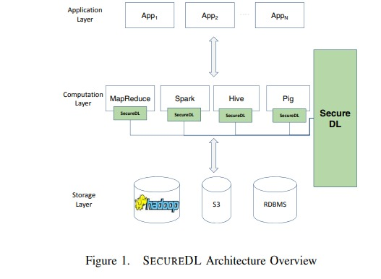
SECUREDL ARCHITECTURE:
SECUREDL system is build on top of existing NoSQL/SQL databases such as Hadoop and Spark.
SECUREDL is totally transparent from the user point of view and does not require any change to the user’s code.
SECUREDL can determine whether the current requests are substantially different compared to past requests.

Slide 10

SECUREDL CAPABILITIES:
To protect the sensitive data stored in NoSQL databases and data lakes, SECUREDL intercepts each user data access/analysis request.
HiveQL is used, our system can automatically re-write the query so that any policy will be enforced automatically.
Information collected by the injected code can be used for fine grained log generation and dynamic intrusion detection.

Slide 11
advantages of securedl
Compared to existing techniques and tools available for protecting big data the SECUREDL provide:
advanced data sanitization,
logging,
intrusion detection,
access control,
policy generation and
management capabilities in an integrated framework across many different data management systems.

Slide 12
Conclusion:
In this paper, we provide an overview of a data security and privacy tool that is designed for providing data security and regulatory compliance support.
This tool is especially designed to provide data security for scenarios where complex AI models are built using the existing structured and unstructured data stored in different NoSQL and SQL databases.

